Slide 1
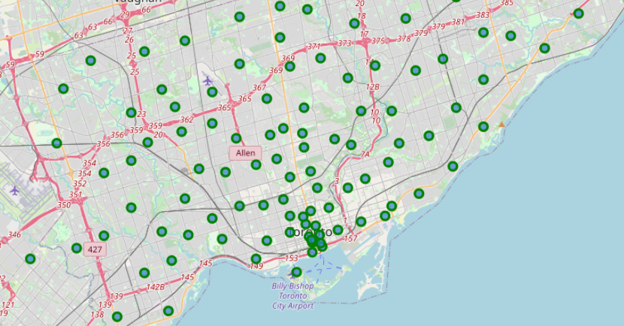
BATTLE OF NEIGHBORHOODS
CAPSTONE PROJECT

Slide 2
BATTLE OF NEIGHBORHOODS –Capstone Project
1.- INTRODUCTION
2.- METHODOLOGY
3.- THE QUESTION
4.- DATA: COLLECTION, REQUERIMENTS & UNDERSTANDING
5.- MODELING
6.- FINAL RESULTS & CONCLUSION

Slide 3


BATTLE OF NEIGHBORHOODS – Introduction
Making the decision to move is not easy.
Among the great changes that this decision implies, why leave something as important as the new place of residence to chance?
Why not take advantage of the great benefits of machine learning to reduce that impact on your life change?

Slide 4
BATTLE OF NEIGHBORHOODS –Capstone Project
1.- INTRODUCTION
2.- METHODOLOGY
3.- THE QUESTION
4.- DATA: COLLECTION, REQUERIMENTS & UNDERSTANDING
5.- MODELING
6.- FINAL RESULTS & CONCLUSION

Slide 5
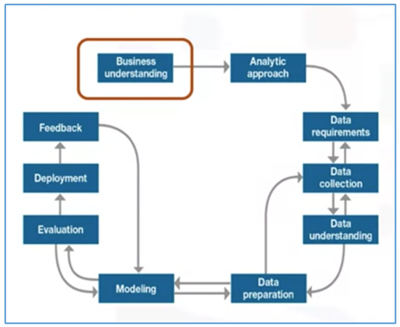
BATTLE OF NEIGHBORHOODS – Methodology
Foundational Data Science Methodology (FDSM)

Slide 6
BATTLE OF NEIGHBORHOODS –Capstone Project
1.- INTRODUCTION
2.- METHODOLOGY
3.- THE QUESTION
4.- DATA: COLLECTION, REQUERIMENTS & UNDERSTANDING
5.- MODELING
6.- FINAL RESULTS & CONCLUSION

Slide 7

BATTLE OF NEIGHBORHOODS – The Question
Business Understanding
What are your basic needs?
What strengths and opportunities should the neighborhood have?
What can discard a zone do?

Slide 8
BATTLE OF NEIGHBORHOODS –Capstone Project
1.- INTRODUCTION
2.- METHODOLOGY
3.- THE QUESTION
4.- DATA: COLLECTION, REQUERIMENTS & UNDERSTANDING
5.- MODELING
6.- FINAL RESULTS & CONCLUSION

Slide 9

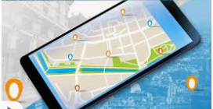

BATTLE OF NEIGHBORHOODS – Data: Collection, Requeriments & Understanding
Data Sources
• Borough/PostalCode data Wikipedia→ https://en.wikipedia.org/wiki/List_of_postal_codes_of_Canada:_M)
• Geospatial data for Toronto → http://cocl.us/Geospatial_data)
• Foursquare API to obtain information about venues and facilities→ https://foursquare.com/

Slide 10
BATTLE OF NEIGHBORHOODS –Capstone Project
1.- INTRODUCTION
2.- METHODOLOGY
3.- THE QUESTION
4.- DATA: COLLECTION, REQUERIMENTS & UNDERSTANDING
5.- MODELING
6.- FINAL RESULTS & CONCLUSION

Slide 11
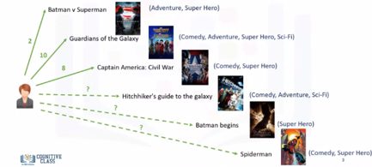
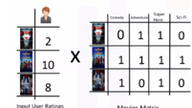
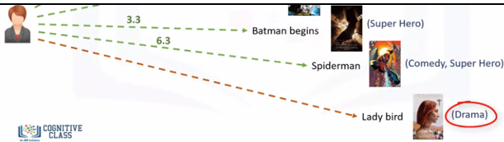
BATTLE OF NEIGHBORHOODS – Modeling
CONTENT-BASED RECOMMENDER SYSTEMS
A Content-based recommendation system tries to recommend items to users based on their profile.
The user's profile revolves around that user's preferences and tastes.
It is shaped based on user ratings, including the number of times that user has clicked on different items or perhaps even liked those items.

Slide 12
BATTLE OF NEIGHBORHOODS –Capstone Project
1.- INTRODUCTION
2.- METHODOLOGY
3.- THE QUESTION
4.- DATA: COLLECTION, REQUERIMENTS & UNDERSTANDING
5.- MODELING
6.- FINAL RESULTS & CONCLUSION

Slide 13
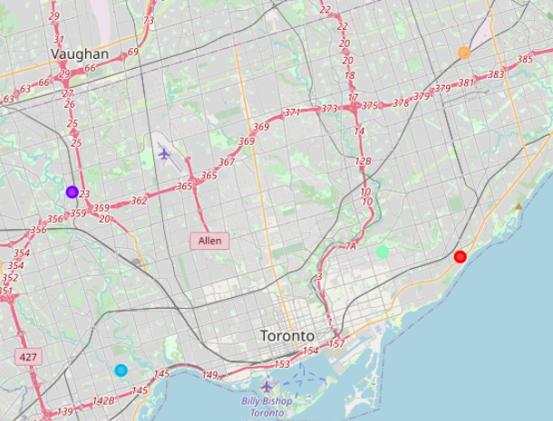
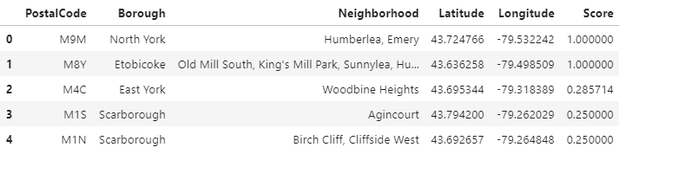
BATTLE OF NEIGHBORHOODS – Final Results and Conclusion
The 2 best neighbourhoods for our first user were “North York Emery” and “Etobicoke, King´s Mill Park”.
2 areas had the same score and the difference amount the other 3 neighbourhoods is big.
Probably our user choices was common, and hey include anything extraordinary as “Airport Food Court”.

Slide 14

BATTLE OF NEIGHBORHOODS – Next Steps
Train the model with more users.
Introduce more parameter to make more selective the differences neighborhood.
Adapt the algorithm to a hybrid model, taking the strong point of both systems (content-based and collaborative filtering)

